Slide 1
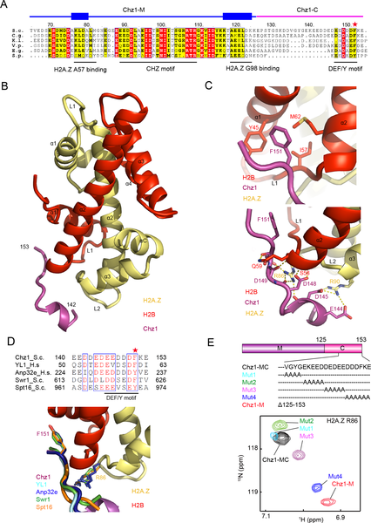

Fig 2. Structure and interaction of Chz1-C in complex of H2A.Z-H2B.
Wang Y, Liu S, Sun L, Xu N, Shan S, et al. (2019) Structural insights into histone chaperone Chz1-mediated H2A.Z recognition and histone replacement. PLOS Biology 17(5): e3000277. https://doi.org/10.1371/journal.pbio.3000277
https://journals.plos.org/plosbiology/article?id=10.1371/journal.pbio.3000277

